Slide 1
Furssan Fight Club
Presented by Furqan Khan and Hassan Fardous
03/05/2024

Slide 2



What and Why
THE IDEA: BOOKING SYSTEM FOR MARTIAL ARTS CLASSES
PURPOSE: To give users the option to book fighting classes, with options of different fighting arts, times, payment methods, etc
A fighting gym's data offers insights on fitness and martial arts enthusiasts, making it attractive for targeted sports and health product ads. Advertisers can use this data to precisely reach individuals interested in their products.

Slide 3
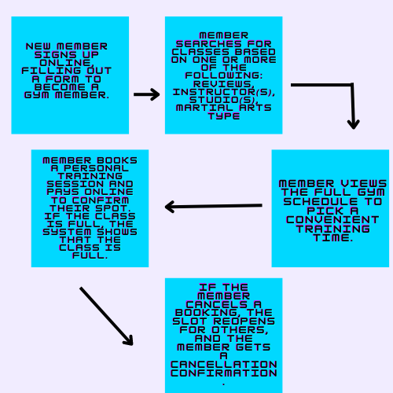
How (describe 2+ functional requirement in user the story telling way)

Slide 4
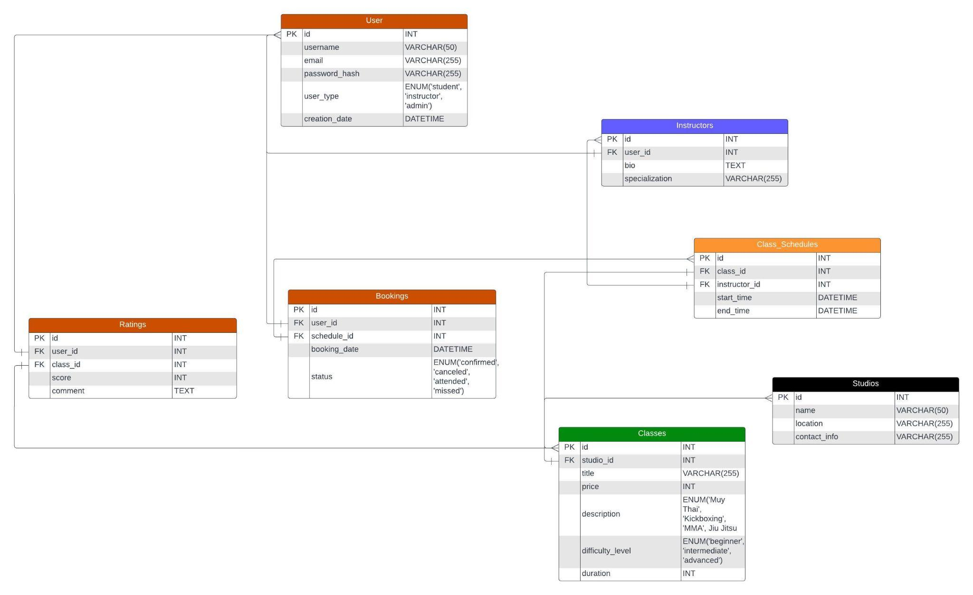

Slide 5

The Stack

Slide 6
Member Roles
FURQAN KHAN
HASSAN FARDOUS
Front-end:
React, JS, CSS
Backend Database: MySQL
Server-side Backend:
Node.js and Express.js
Database: MySQL

Slide 7
Q&A

